Slide 1
Lab 5 – Joke App
e_lin67330@fanshaweonline.ca

Slide 2
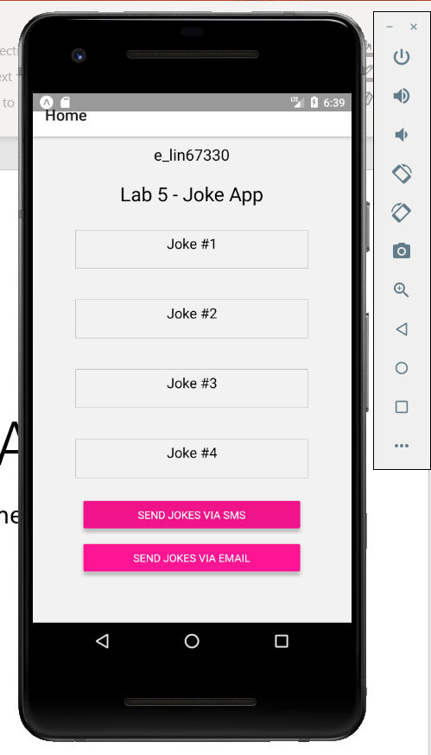
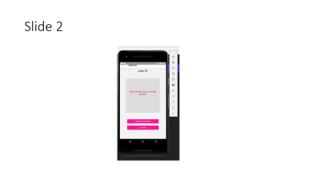
Slide 1

Slide 3
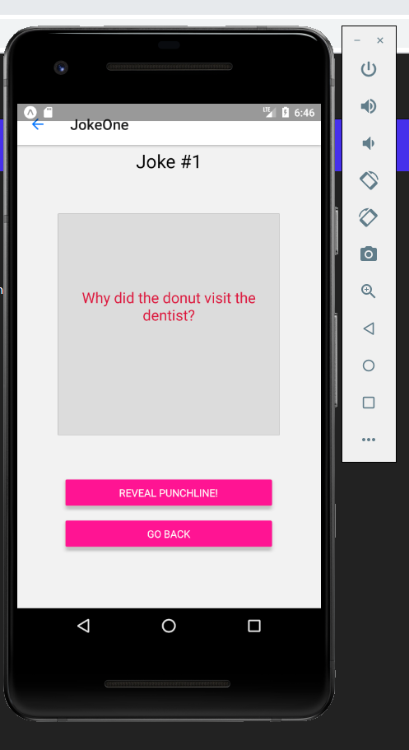
Slide 2

Slide 4
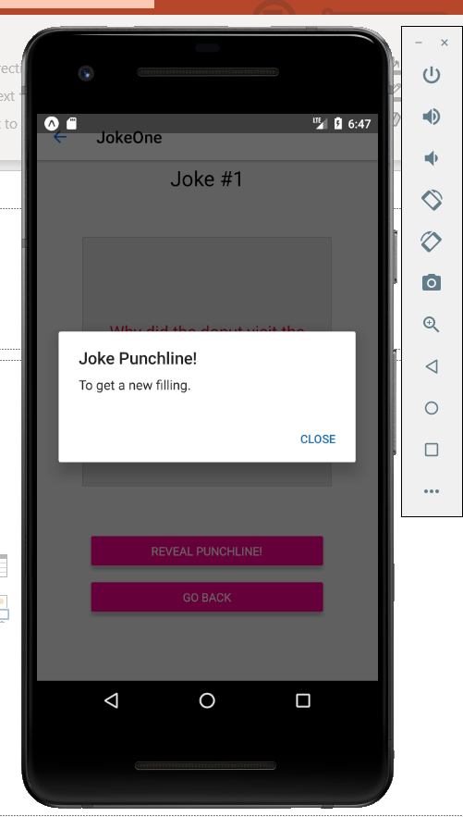
Slide 3

Slide 5
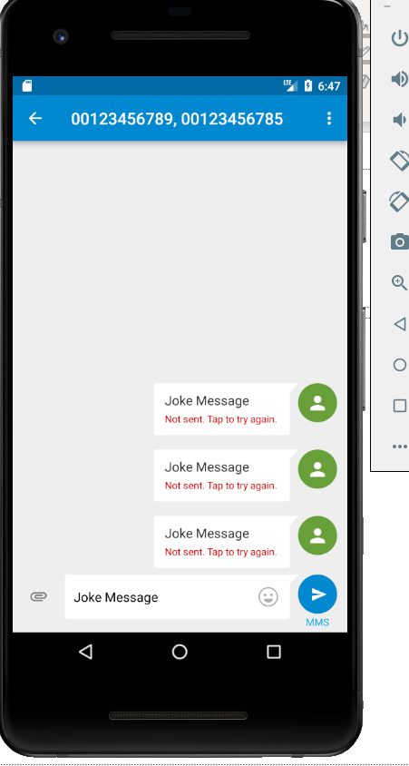
Note: MMS not available on this network

Slide 6
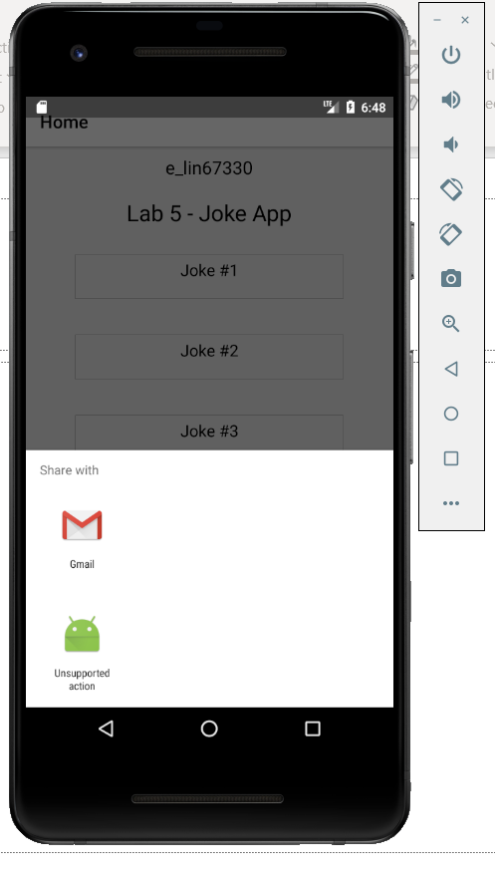
Compose message example

